Slide 1
CYTOAUTOCLUSTER
Enhancing Cytometry with Deep Learning
- AKASH

Slide 2
CONTENTS
Introduction
EDA Techniques
Visualizing the data
Machine Learning models
Gradio Implementation

Slide 3
Model Flowchart
Load Dataset
Preprocessing Techniques
Semi-Supervised learning
Visualize clusters
Gradio Implementation

Slide 4
Introduction
CytoAutoCluster is an innovative solution designed to enhance the analysis of high-dimensional cytometry data by clustering cells based on unique, identifiable characteristics.
Leveraging semi-supervised learning techniques, it integrates both labeled and unlabeled data to improve clustering accuracy and computational efficiency.
The Levine_32dim dataset, sourced from Levine et al. (2015), comprises 265,627 cells characterized by 32 markers. Of these, 39% (104,184 cells) are manually labeled into 14 clusters, while the remaining 61% (161,443 cells) are unlabeled.

Slide 5
EDA Techniques
A correlation matrix in machine learning is used to visualize and identify the relationships between different features in a dataset, allowing data scientists to understand which variables are highly correlated with each other.
Null vs. Non-Null Values bar plot representation done to Identify missing data patterns to guide imputation or removal strategies.
A histogram in machine learning is used to visualize the distribution of a single variable, helping data scientists understand its frequency, range, and potential outliers in the dataset
Skewness and kurtosis is a statistical measure that helps determine how asymmetric a distribution and it will help to find the outliers in the dataset

Slide 6
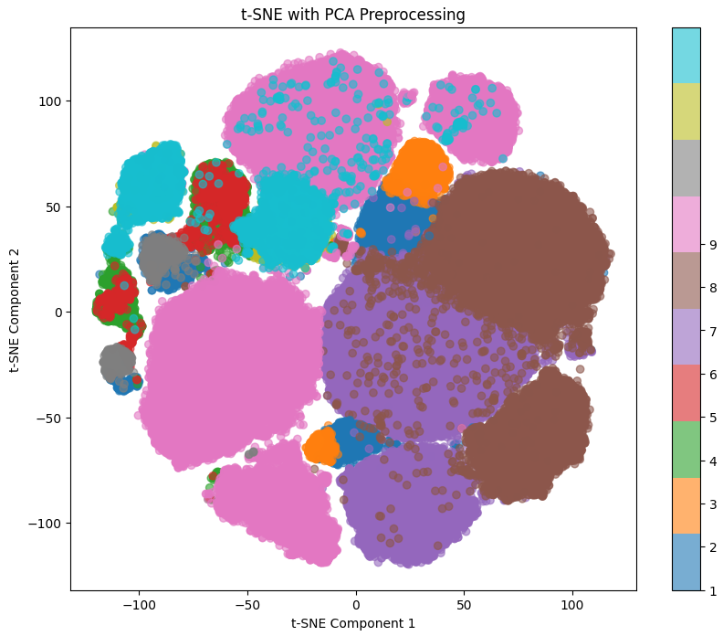
Visualizing the data
T-SNE and PCA :
These used primarily for dimensionality reduction, which means transforming complex, high-dimensional data into a lower-dimensional space, making it easier to visualize and analyze patterns within the data.
Clusters represent groups of data points that share similar characteristics or patterns. A well clustered output represents they are well-separated in the feature space with minimal overlap
Fig : T-SNE output before encoder model

Slide 7
Model Architecture and Implementation
Logistic Regression: A linear model used for classification, predicting probabilities for different classes.
XG Boost: A gradient boosting algorithm known for its performance and efficiency in classification tasks.
Self-Supervised Model: An autoencoder-based model used for unsupervised feature learning, particularly from unlabeled data. It involves mask and feature estimation.
Semi-Supervised Model: This model combines labeled and unlabeled data for training, using an encoder and predictor to generate predictions for unlabeled data.

Slide 8
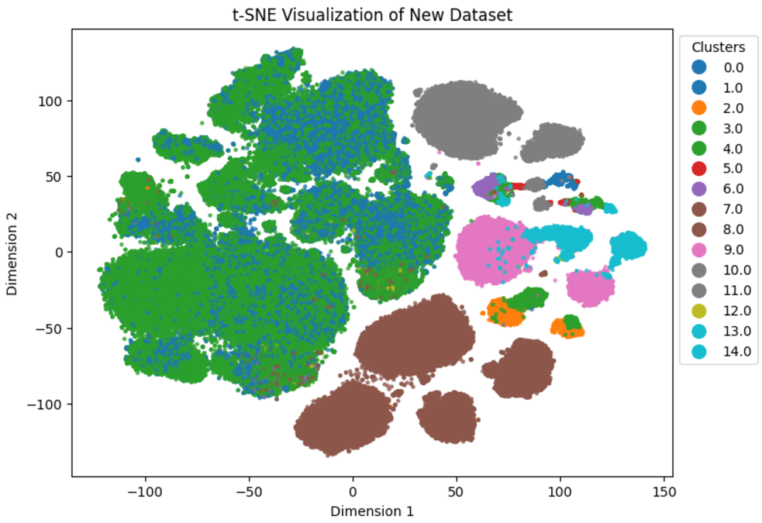
Results
Logistic Regression Log Loss: 0.027
XGBoost Log Loss : 0.054
Self-Supervised Model Accuracy: 97.5%
AUROC: 99.16%
Fig : T-SNE Output after predicting the labels

Slide 9
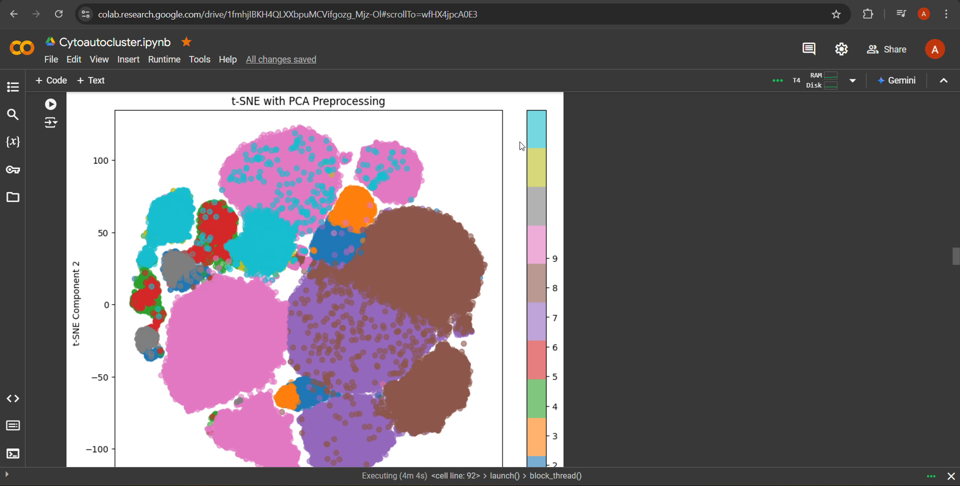
Gradio Implementation
To create an interactive user interface (UI) for your machine learning model
Displayes the t-sne and the predicted labels of the inputed rows

Slide 10
THANKYOU

